Slide 1

2018 SW Internship Project Proposal (CDI)
-Team 5 <4 idiots >

Slide 2




Team Introduction
Developments
Outline
Motivation
Development purpose & Expectation effectiveness
Major Function
Plans
Developments

Slide 3
Team<4 idiots> Introduction
Choi Ayoung / Electronic Engineering / Leader / developing connection between H/W and application
Kim Minju / Electronic Engineering / making a network of insecticide and application
Lee Junghoo / Electronic Engineering / building a database of setting point
Kim Donghee / Computer Science & Engineering / programming & UI design

Slide 4
Outline
We implement automatic spray system using interlock between the insecticide and Android application which is operated on user’s smartphone.
When user activates the application, the system compares current temperature and humidity with setpoint. If the measured value reaches to setpoint, the insecticide starts being sprayed periodically.

Slide 5
Motivation
India has many mosquitoes and has a population of many diseases associated with them because of the tropical climates.
according to acquaintances who have been to India, they had very tough time in India because of dengue fever.
So, the products that are able to combat the pests or allow to avoid them are easy to success in India.
Considering these conditions of India, we came out with a system that would be helpful to resolve these difficulties.

Slide 6
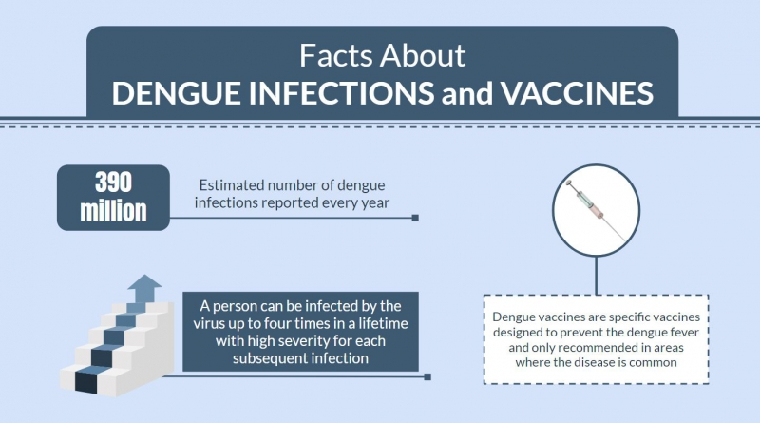
Dengue Fever Status

Slide 7
Development purpose &Expectation effectiveness
prevent illness caused by pests
reduce inconvenience by easy and quick access to controlling insecticide
application for other field such as air freshener

Slide 8
Major Function
Compare the input value (current temperature and humidity) with setting value (temperature and humidity where pests act the most actively)
If the input value reaches to the range of setting value, the system allows insecticide to be sprayed periodically.
User can check the residual amount of the insecticide on user’s smartphone and receive a push alarm when it is insufficient.

Slide 9
Plans
July 1st week | Telecommunication
July 2nd week | Programming & Developing application
July 3rd week | Programming & Developing application
July 4th week | Debugging & Test
July 5th week | Debugging & Test

Slide 10


